Slide 1


Walchand College Of Engineering, Sangli
(An Government Aided Institute)
Department Of Information Technology
(Academic year 2022-23)
Project Presentation
on
Study and design cheetah optimizer algorithm

Slide 2
Walchand College Of Engineering, Sangli
(An Government Aided Institute)
Department Of Information Technology
Institute Name : Walchand College Of Engineering, Sangli
Institute code : 6007
Class : Final Year
Course: Information Technology
Project Instructor: Prof. Mr. A.J. Umbarkar Sir
Prepared by :-
Name | PRN No
Sakshi Kamble | 2020BTEIT00205
Pranjali Nanaware | 2019BTEIT00067
Arundhati Wandhekar | 2019BTEIT00013
Pratik Pawar | 2019BTEIT00006
Rahul Kumar | 2019BTEIT00002

Slide 3
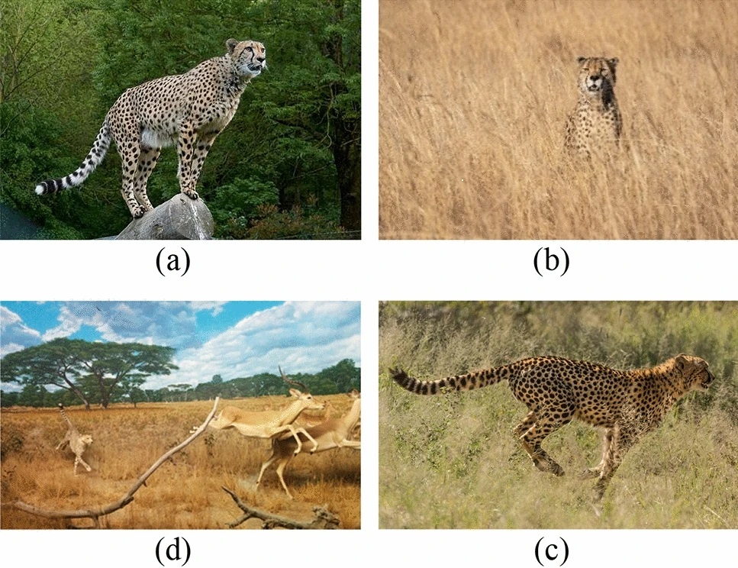
Problem Statement :
Walchand College Of Engineering, Sangli
(An Government Aided Institute)
Department Of Information Technology
Study and Design Cheetah Optimizer Algorithm
and solve real world problem.

Slide 4
Introduction:
Walchand College Of Engineering, Sangli
(An Government Aided Institute)
Department Of Information Technology
The Cheetah Optimization Algorithm (COA) is a recently developed population-based optimization algorithm inspired by the hunting behavior of cheetahs. Cheetahs are known for their speed and agility when hunting prey, and the COA aims to mimic this behavior to efficiently search for optimal solutions in complex optimization problems.
The COA is a type of metaheuristic algorithm, which means that it does not rely on explicit mathematical models of the problem being optimized. Instead, it uses a population of candidate solutions and iteratively improves them through a combination of local and global search strategies.

Slide 5
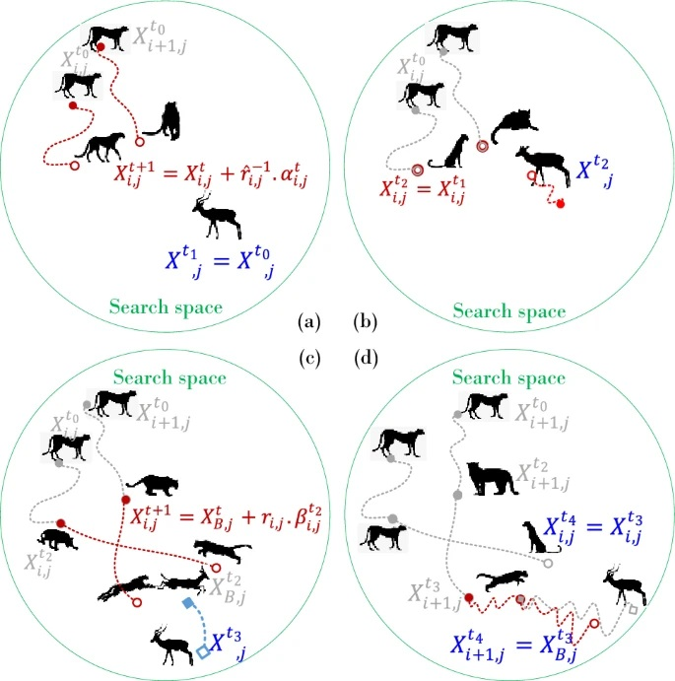
Objectives :
Walchand College Of Engineering, Sangli
(An Government Aided Institute)
Department Of Information Technology
To study and understand Cheetah Optimizer algo for optimization
To analyze the result and compare it with other algorithm
To solve real life problem on cheetah optimizer algorithm

Slide 6
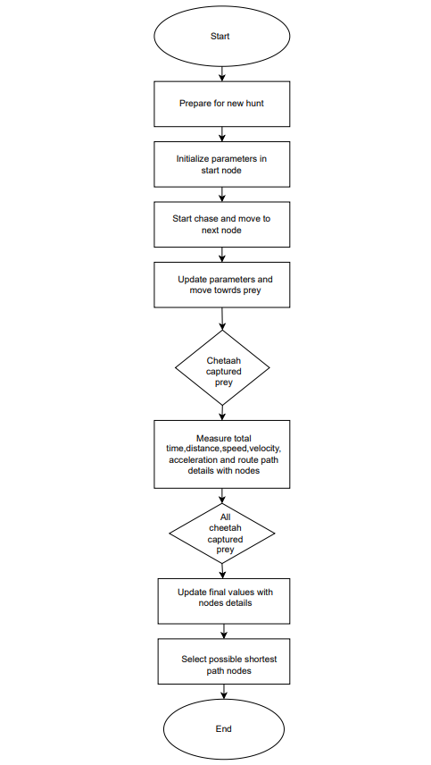
Flow Of System :
Walchand College Of Engineering, Sangli
(An Government Aided Institute)
Department Of Information Technology

Slide 7
Walchand College Of Engineering,Sangli
(An Government Aided Institute)
Department Of Information Technology
Methodology
Search strategy equation :
where
n →Number of cheetahs population
D → Dimension of the optimization problem.
X^{t+1}_{i,j} → Next position of cheetah i in arrangement j
X^{t}_{i,j} → Current positions of cheetah i in arrangement j
t → Current hunting time
T → maximum length of hunting time.
r^{^-1}_{i,j} → Randomization parameter
α^{t}_{i,j} → step length for cheetah i in arrangement
X^{t+1}_{i,j} = X^{t}_{i,j} + r^{^-1}_{i,j} * α^{t}_{i,j}

Slide 8

Walchand College Of Engineering,Sangli
(An Government Aided Institute)
Department Of Information Technology
Methodology
2 Sit-and-wait strategy equation :
X^{t+1}_{i,j} → Updated positions of cheetah i in arrangement j
X^{t}_{i,j} → Current positions of cheetah i in arrangement j
3 Attack equation :
X^{t}β,j →Current position of the prey in arrangement j (current best position)
r^_{i,j} → Turning factor
β^{t}_{i,j} → Interaction factor associated to the cheetah i in arrangement j.
X^{t+1}_{i,j} = X^{t}_{i,j}

Slide 9
Walchand College Of Engineering,Sangli
(An Government Aided Institute)
Department Of Information Technology
Algorithm
Define the problem data,dimension(D),and the initial population size(n)
Generate the initial population of cheetahs Xj(i=1,2,.....n) and evaluate the fitness of each cheetah
Initialize the populations home,leader and prey solutions
t <- 0
it <- 1
MaxIt <- desired maximum number of iterations
T <- 60 x [D/10]
while it <= Maxlt do
Select m(2 <= m <= n) members of cheetahs randomly
for each member i E m do
Define the neighbour agent of member i
for each arbitrary arrangement j {1,2,....D} do
Calculate r^,r,a,b, and H
14. r2,r3 <- random numbers are chosen uniformly from 0 to 1
15. if r2 <= r3 then
16. r4 <- a random number is chosen uniformly from 0 to 3
17. if H >= r4 then
18. Calculate the new position of member i in arrangement j using Equation (3) // Attack

Slide 10
Walchand College Of Engineering,Sangli
(An Government Aided Institute)
Department Of Information Technology
Algorithm
19. else
20. Calculate the new position of member i in arrangement j using Equation (1) // Search
21. end
22. else
23. Calculate the new position of member i in arrangement j using Equation (2) // Sit-and-wait
24. end
25. end
26. Update the solutions of member i and the leader
27. end
28. t <- t + 1
29. if t > r and x T and the leader position doesn’t changes for a time, then //Leave the prey and go back home
30. Implement the leave the prey and go back home strategy and change the leader position
31. Substitute the position of member i by prey position
32. t <- 0
33. end
34. it <- it + 1
35. Update the prey (global best) solution
36. end

Slide 11

Walchand College Of Engineering,Sangli
(An Government Aided Institute)
Department Of Information Technology
Example:
Sphere function using COA :
Sphere function is a well known optimization problem.
Following are the steps to solve sphere function using COA algorithm.
step 1 : Initialize the population of cheetah in the search space[-5 , +5]
Index | X1 | X2 | F(X)
1 | -3.5 | 1.2 | 11.68
2 | 2.3 | -4 | 21.24
3 | 0.8 | 3.9 | 15.85
4 | -2.6 | 0.9 | 7.57
mean | -3 | 2

Slide 12
Walchand College Of Engineering,Sangli
(An Government Aided Institute)
Department Of Information Technology
Example:
Step 2 : Evaluate the fitness of each solution using the sphere function
Step 3 : Identify the best solution (cheetah) based on fitness
Step 4 : update the position of each cheetah.initialize the random value to 0.5
Now using the equation X_new = X_old + r * (X_best - X_old)
index | X1 | X2 | F(X)
1 | -3.05 | 1.05 | 10.40
2 | -0.15 | -1.55 | 2.38
3 | -0.9 | 1.5 | 1.44
4 | -2.6 | -0.9 | 7.5

Slide 13
Walchand College Of Engineering,Sangli
(An Government Aided Institute)
Department Of Information Technology
Example:
Step 5 : Evaluate the fitness of the new solutions.
Step 6 : Replace the worst solutions in the population with the new solutions.
compare the two tables and select best one.
Index | X1 | X2 | F(X)
1 | -3.5 | 1.2 | 11.68
2 | 2.3 | -4 | 21.24
3 | 0.8 | 3.9 | 15.85
4 | -2.6 | 0.9 | 7.57
mean | -3 | 2
Index | X1 | X2 | F(X)
1 | -3.05 | 1.05 | 10.40
2 | -0.15 | -1.55 | 2.38
3 | -0.9 | 1.5 | 1.44
4 | -2.6 | -0.9 | 7.5

Slide 14
Walchand College Of Engineering,Sangli
(An Government Aided Institute)
Department Of Information Technology
Example:
Step 7: Repeat steps 3-6 until a stopping criterion is met
So the Final Result is :
Best Solution is : [-0.9 , 1.5]
Best objective is : 1.44
Index | X1 | X2 | F(X)
1 | -3.05 | 1.05 | 10.40
2 | -0.15 | -1.55 | 2.38
3 | -0.9 | 1.5 | 1.44
4 | -2.6 | -0.9 | 7.5

Slide 15
Walchand College Of Engineering,Sangli
(An Government Aided Institute)
Department Of Information Technology
ELD Problem:
Economic Load Dispatch (ELD) is a well-known problem in power system optimization, which involves allocating power output among different generators to meet the demand at a minimum operating cost while satisfying various system constraints
Here are the steps to solve ELD using the Cheetah optimization algorithm:
Step 1: Define the problem statement and objective function
Step 2: Define the decision variables and constraints
The decision variables are the power output of each generator.

Slide 16
Walchand College Of Engineering,Sangli
(An Government Aided Institute)
Department Of Information Technology
ELD Problem:
The constraints can include:
the power balance constraint
the capacity constraint
Step 3: Implement the Cheetah optimization algorithm
Select the electrical park group with n generating unit.
Perform crossover and mutation operations to get minimized fuel cost.
Evaluate the power output and fuel cost coefficients.
Evaluate the total real power demand and loss and total generated power..
Step 4: Test and validate the solution

Slide 17

Walchand College Of Engineering,Sangli
(An Government Aided Institute)
Department Of Information Technology
ELD Problem Formulation:
Consider an electrical groups park with n generating units. The total fuel cost for power generation to be minimized is the sum of contributions of each generating units
Fi is the fuel cost function for the generation unit i (in $/h) and Pi (in MW) is the real power output for this unit.
The fuel cost of each generation unit i is represented by a quadratic equation.

Slide 18
ELD Problem Formulation:
Walchand College Of Engineering, Sangli
(An Government Aided Institute)
Department Of Information Technology
F_{i}(P_{i}) = a_{i}P²_{i} +b_{i}P_{i}+c_{i}
ai, bi and ci are the fuel cost coefficients of the unit i
min(Pi) and max(Pi) are the minimum and maximum generation limits of unit i.
P^{min}_{i} <= P_{i}<= P_{i}^{max}
The total generated power by the units must be equal to the sum of total load demand and total real power loss in the transmission lines, as follows

Slide 19
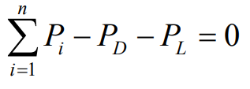
ELD Problem Formulation:
Walchand College Of Engineering, Sangli
(An Government Aided Institute)
Department Of Information Technology
PD is the total system real power demand (in MW)
PL is the overall system real power losses (in MW)
Input Values:
Unit | 𝑎_{𝑖} | 𝑏_{𝑖} | 𝑐_{𝑖} | 𝑃𝑚𝑖𝑛 | 𝑃𝑚𝑎𝑥
1 | 0.007 | 7 | 240 | 100 | 500
2 | 0.0095 | 10 | 200 | 50 | 200
3 | 0.009 | 8.5 | 220 | 80 | 300
4 | 0.009 | 11 | 200 | 50 | 150
5 | 0.008 | 10.5 | 220 | 50 | 200
6 | 0.0075 | 12 | 120 | 50 | 120

Slide 20
Output and comparison:
Walchand College Of Engineering, Sangli
(An Government Aided Institute)
Department Of Information Technology
Output of ELD problem using COA algorithm:
Comparison:
Iteration | Best Solution | Total Cost
500 | [100.25, 71.06, 90.84, 58.44, 71.11, 50.74] | 5666.214
POWER DEMAND (MW) | FUEL COST ($) |  |  | POWER LOSS (Mw) |  |  | COMPUTATION (SECONDS) |  | TIME
 | BOA | GA | PSO | BOA | GA | PSO | BOA | GA | PSO
500 | 6132.5 | 6147.6 | 6132.2 | 5.5507 | 5.6540 | 5.5844 | 3.9438 | 11.6819 | 97.9637
 | 6 | 2 | 6 |  |  |  | 66 | 95 | 07

Slide 21
Technology :
Walchand College Of Engineering, Sangli
(An Government Aided Institute)
Department Of Information Technology
Python

Slide 22

Walchand College Of Engineering,Sangli
(An Government Aided Institute)
Department Of Information Technology
References
https://www.nature.com/articles/s41598-022-14338-z
https://www.researchgate.net/publication/361610357_The_cheetah_optimizer_a_nature-inspired_metaheuristic_algorithm_for_large-scale_optimization_problems
https://www.semanticscholar.org/paper/Cheetah-Based-Optimization-Algorithm%3A-A-Novel-Swarm-Klein-Mariani/da1f48f193e420255b9603263cf369d110ead907

Slide 23


